Slide 1
The Roundtable Live! Manteno, IL, August 9, 2018 A networking event with educational demonstrations for underground utility contractors and utilities Begins 11:00 AM

Slide 2
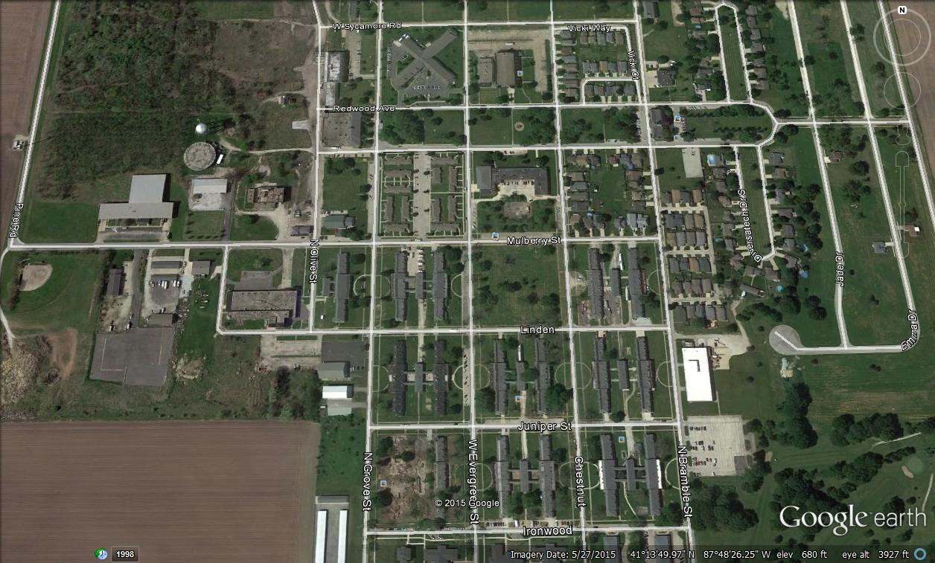

Slide 3
A social, picnic setting with outdoor demonstrations
Not a trade show but an opportunity to learn through networking and participation in live demonstrations
Excavation equipment onsite
In December, The Roundtable produces a lot of conversation about the future of our industry. In August, you can see it and do it at The Roundtable Live!
An opportunity to exchange food, beverage and ideas with the brightest in the business.

Slide 4
Not a trade show but an opportunity to learn through networking and participation in live demonstrations
There aren’t two sides of the aisle at The Roundtable Live! The event is a Midwestern picnic-style setting where people come together to discuss the future of damage prevention and the underground utility industry.

Slide 5
Excavation equipment onsite
With the support of area utility contractors, excavation equipment will be onsite to assist with demonstrations throughout the event.

Slide 6
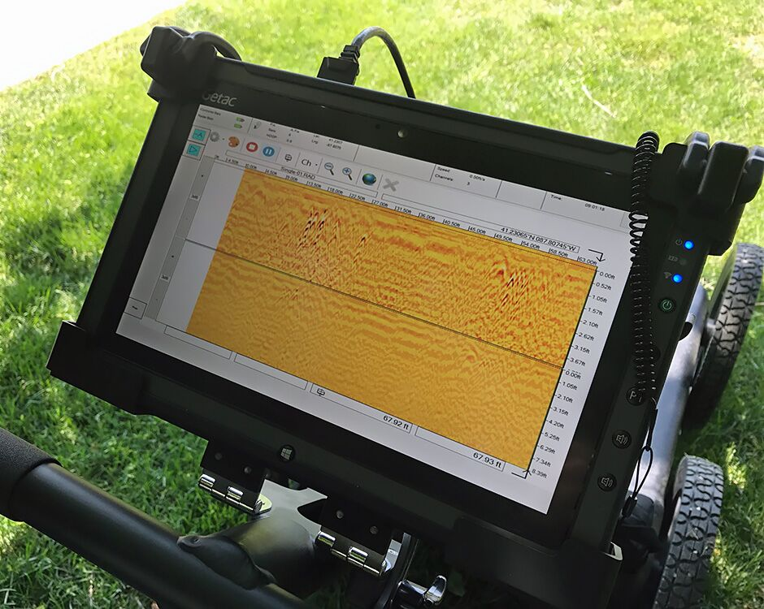
In December, The Roundtable produces a lot of conversation about the future of our industry. In August, you can see it and do it at The Roundtable Live!
There’s going to be a time when placing paint and flags to mark buried lines for excavation is an obsolete practice. When underground utility location databases are populated and shared, it will pave the way for the use of artificial intelligence in underground utility construction and maintenance activities.
We will place a special emphasis on demonstrations that show products connecting the locating of buried lines with information for the excavator.

Slide 7
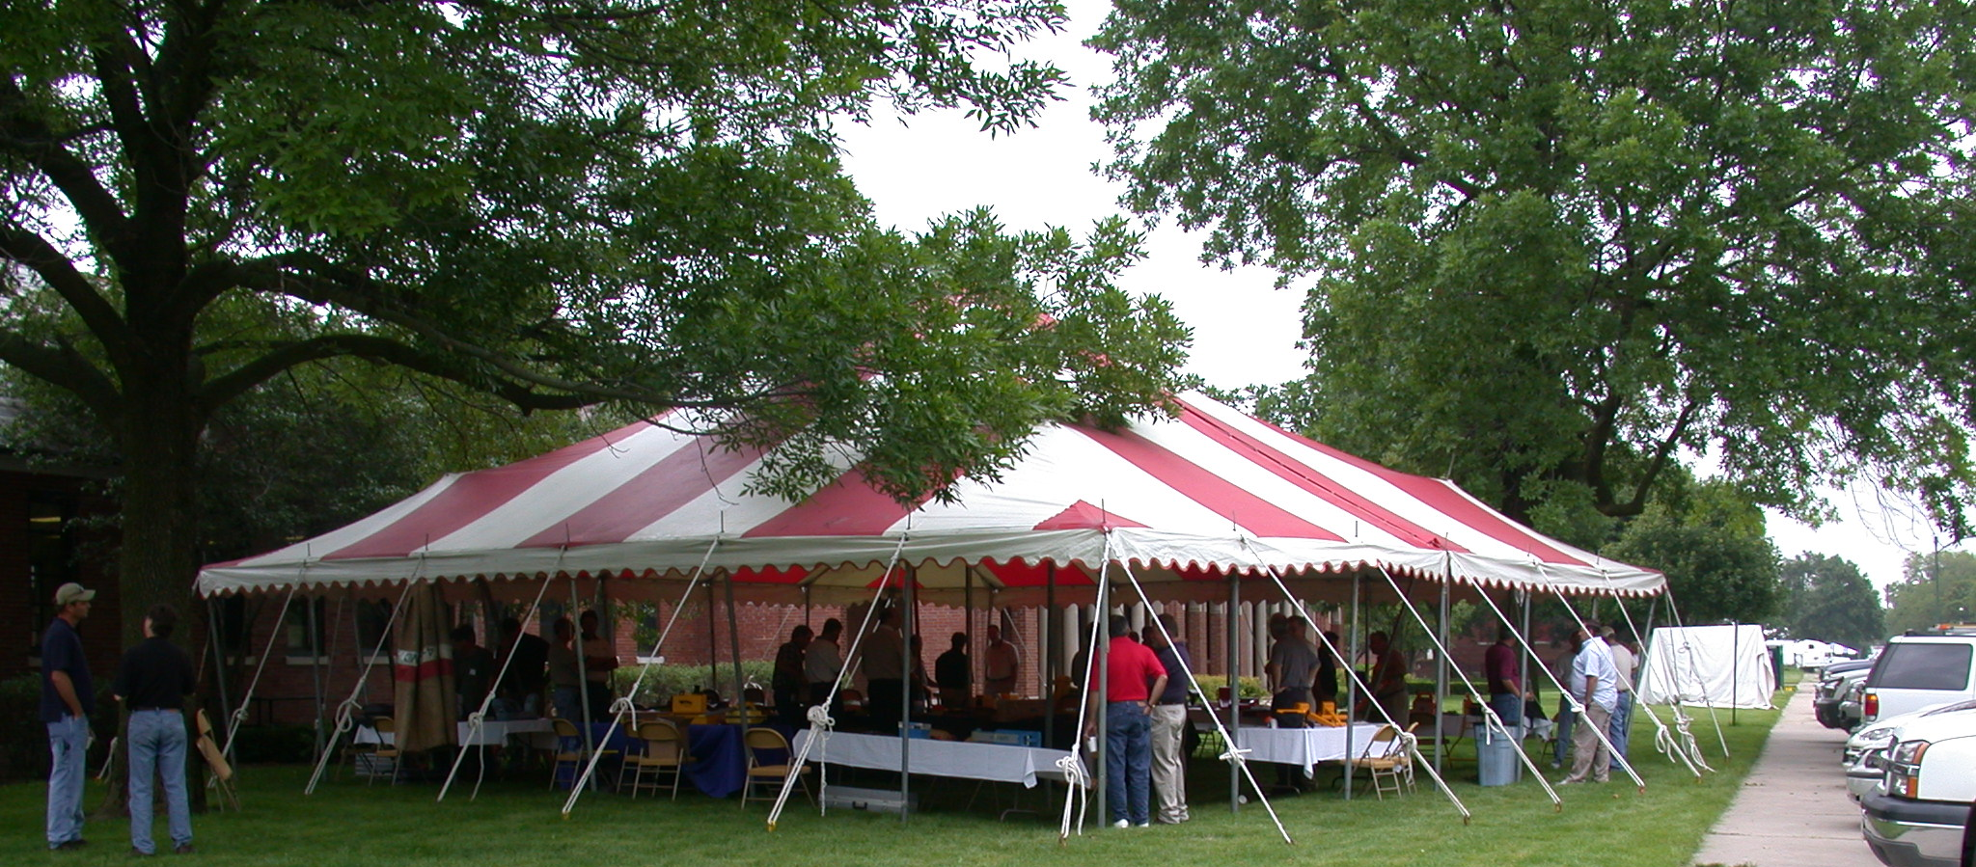
An opportunity to exchange food, beverage and ideas with the brightest in the business.

Slide 8
Participation Fees
For attendees: 45.00
For companies with product or service demos: $250.00
(companies involved with high-level demos will pay more)
We will be seeking five utility contractor sponsors, two utility company sponsors, and two damage prevention organization sponsors to assist with the food and beverage and other costs associated with the event.

